Slide 1
LINUX
Week 1

Slide 2
01
INTRODUCTION TO LINUX
Who is that penguin?

Slide 3

What is Linux?
Tux
“Linux is a family of open source Unix-like operating systems based on the Linux kernel, an operating system kernel first released on September 17, 1991, by Linus Torvalds. Linux is typically packaged in a Linux distribution.” - Wikipedia

Slide 4

Brief History of Linux

Slide 5
Linux Distributions
A Linux distribution (often abbreviated as distro) is an operating system made from a software collection that is based upon the Linux kernel and, often, a package management system.

Slide 6

Linux Distributions - Examples

Slide 7
WHERE IS LINUX USED TODAY
Desktops
Servers
Embedded Systems
Linux currently powers over 90% of the internet, and is gaining massive traction in the enterprise sector for powering their systems.
Linux provides an powerful open source alternative to proprietary operating systems currently being used worldwide.
Linux forms the backbone for many embedded systems, from home internet modems to industrial control systems.

Slide 8
Questions?

Slide 9
02
Installing Linux
Setting up and Deploying our first system

Slide 10
Step 1 - Downloading & Installing Virtualbox
One of the methods to install Linux is using a Virtualization software.
VirtualBox is free and open source virtualization software from Oracle. It enables you to install other operating systems in virtual machines.
To install Virtualbox, we need to download the Virtualbox installer from the download page https://www.virtualbox.org/wiki/Downloads
After downloading it, just follow the steps presented to you.

Slide 11
Step 2 - Downloading Ubuntu ISO
We need to download a Linux distribution image to install it using Virtualbox.
We will be using Ubuntu Desktop 20.04.3 LTS, you can download it from this link https://ubuntu.com/download/desktop
There are different methods of downloads available
Direct Link
Torrent File
Network Installers
Other Resources

Slide 12
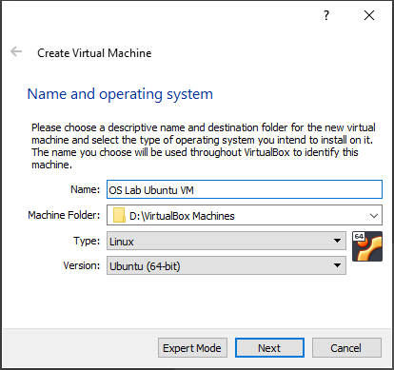
Step 3 - Creating a New Virtual Machine
Open Virtualbox
To create a new virtual machine, we click on the New button
Enter the name of the Virtual Machine. The name can be anything that you want, preferably it should state the purpose of the machine or the name of the operating system. E.g. Ubuntu, OS Lab Ubuntu Machine
Select
Folder: Where to store the VM Files. Example: D:/VMs/
Type: Type of OS. Example: Linux
Version: Version of the OS. Example: Ubuntu 64-bit

Slide 13
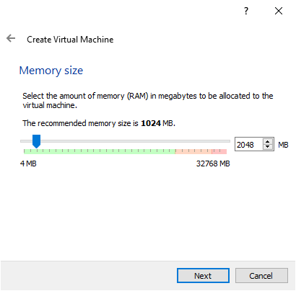
Step 3 - Creating a New Virtual Machine
Allocate RAM to the VM. Make sure not to give the VM more RAMs that you system can handle.

Slide 14
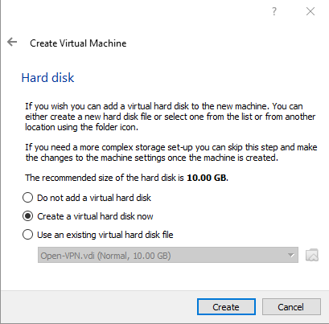
Step 3 - Creating a New Virtual Machine
Create a virtual disk. This will serve as the hard disk of the VM.

Slide 15
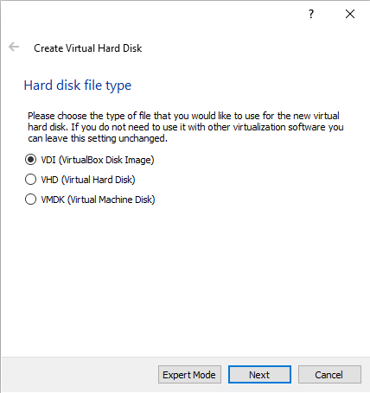
Step 3 - Creating a New Virtual Machine
Choose the hard disk file type. I recommend using VDI.

Slide 16
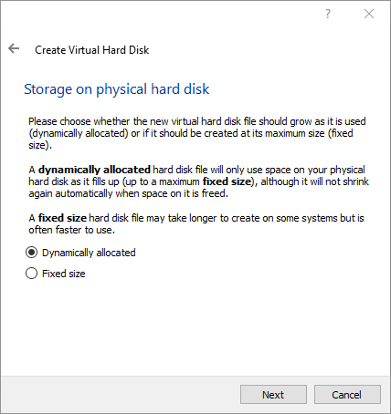
Step 3 - Creating a New Virtual Machine
Specify the format of the storage on the hard disk. You can either choose
Dynamically Allocated (Recommended): Will only use space on your physical hard disk as it fills up.
Fixed Size: Will allocate the whole storage from the start.

Slide 17
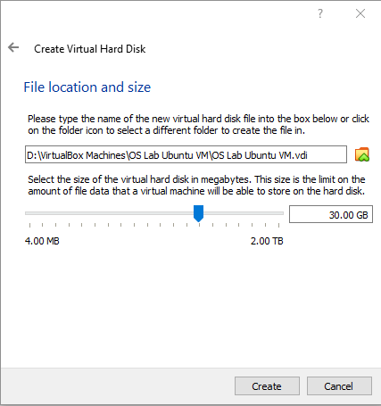
Step 3 - Creating a New Virtual Machine
Specify the hard disk name, location and size.

Slide 18
Step 3 - Creating a New Virtual Machine
Now we need to add the Ubuntu Desktop iso to the VM so we can boot from it to install Ubuntu. We do this in two different methods:
Method 1 (Check Image next slide)
Clicking on the VM inside Virtualbox
Clicking the settings button or we right-click the selected VM and select settings
In the settings menu, we click on Storage.
Under Controller: IDE we
Click on Empty
Click on the disk icon to the right
Click on Choose a Disk File
We select the ISO file that we have downloaded before
Click Ok
Method 2
Clicking on the VM inside Virtualbox
Clicking on the Start Button
Select ISO file.

Slide 19
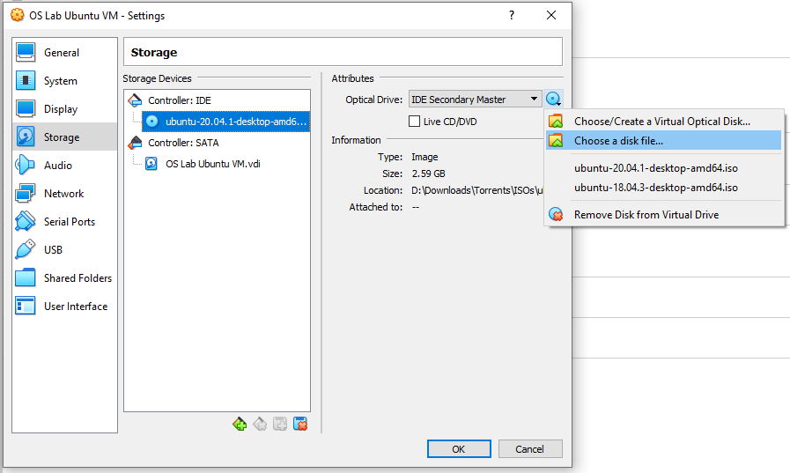
Step 3 - Creating a New Virtual Machine

Slide 20
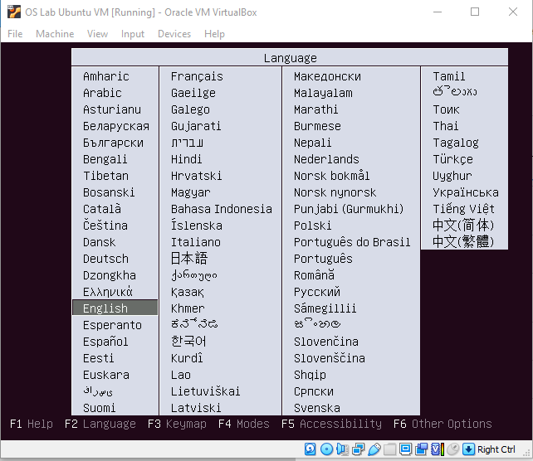
Step 4 - Installing Ubuntu
Start the machine
It will automatically boots from the ISO. (If it didn't, then make sure to attach the iso image to the VM)
Select the language

Slide 21
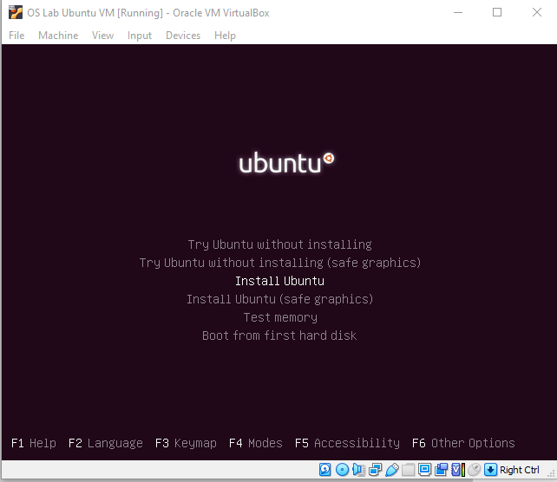
Step 4 - Installing Ubuntu
Choose Install Ubuntu. You can also choose Try Ubuntu if u want to try ubuntu without actually installing it.

Slide 22
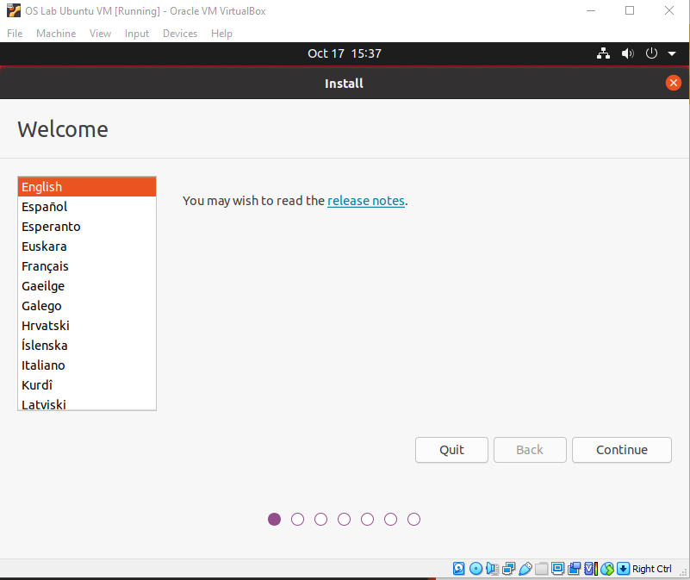
Step 4 - Installing Ubuntu
Select Operating System Language

Slide 23
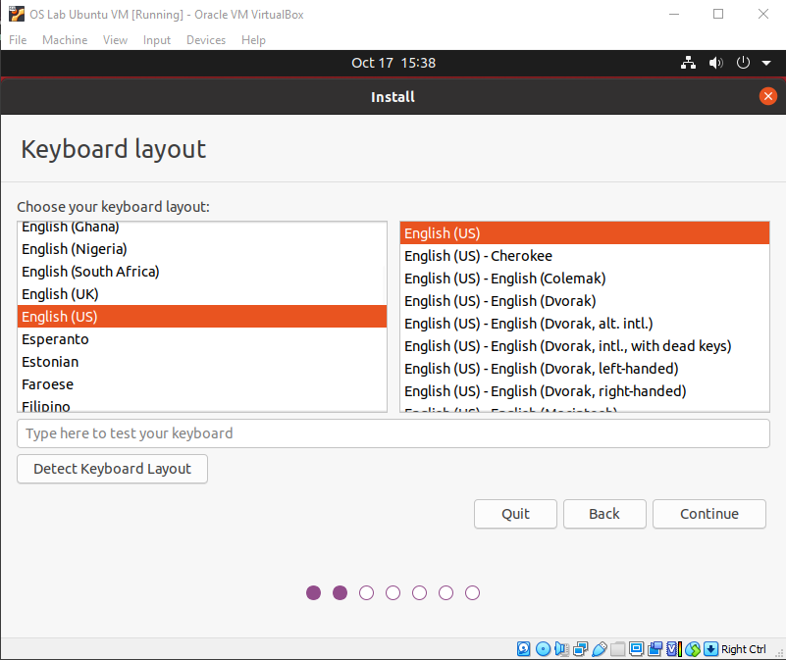
Step 4 - Installing Ubuntu
Select Keyboard Layout

Slide 24
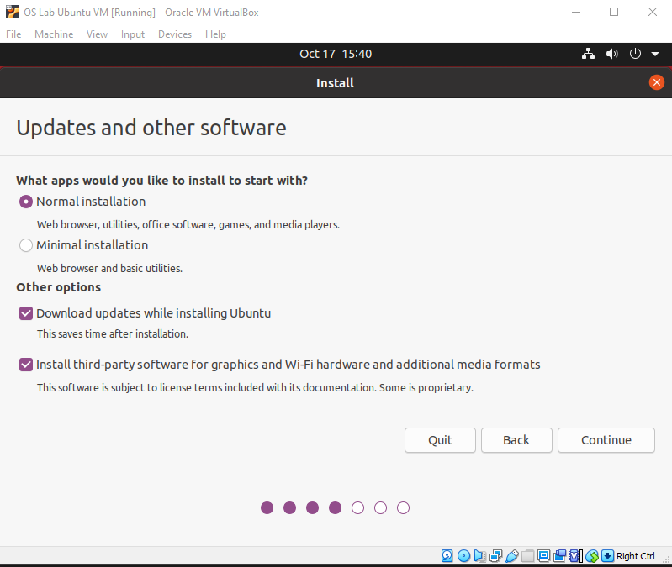
Step 4 - Installing Ubuntu
Specify updates & other software such as Updates and 3rd party software

Slide 25
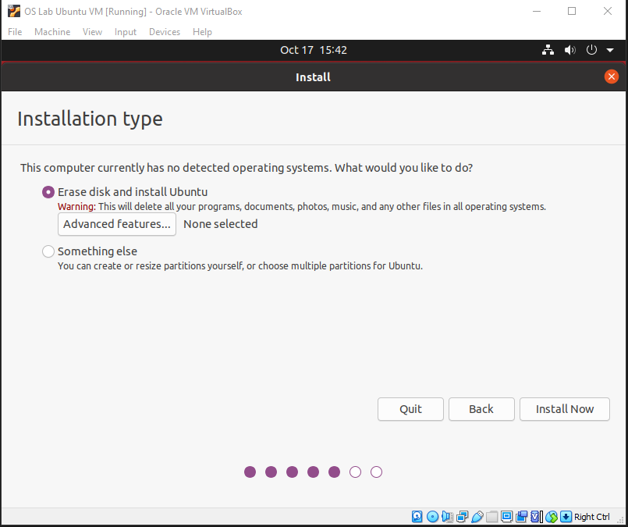
Step 4 - Installing Ubuntu
Select how you want to partition the disk and install the OS. Since we using a VM, we can safely choose “Erase disk and install Ubuntu”.

Slide 26
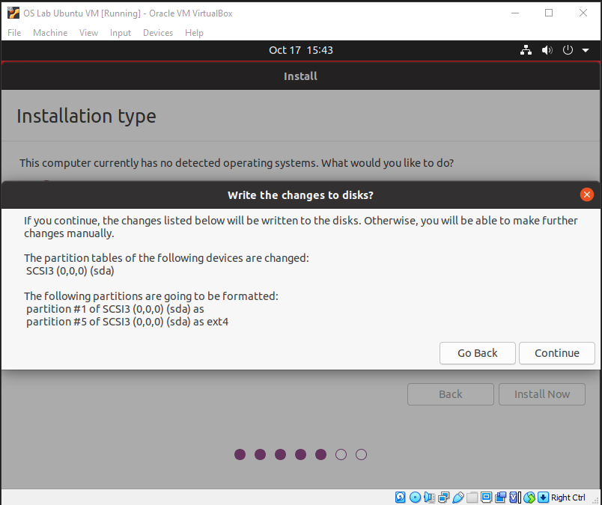
Step 4 - Installing Ubuntu
Click Continue

Slide 27
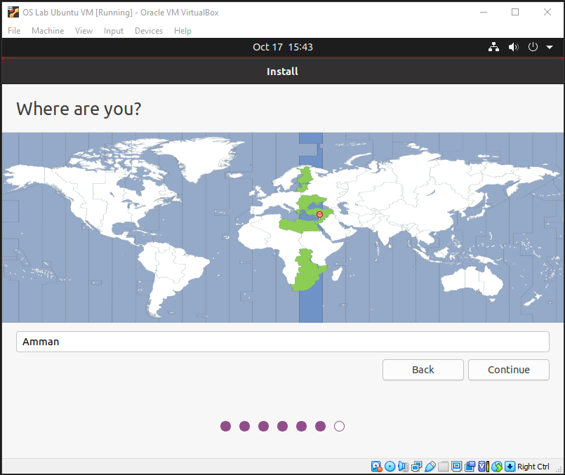
Step 4 - Installing Ubuntu
Choose your location

Slide 28
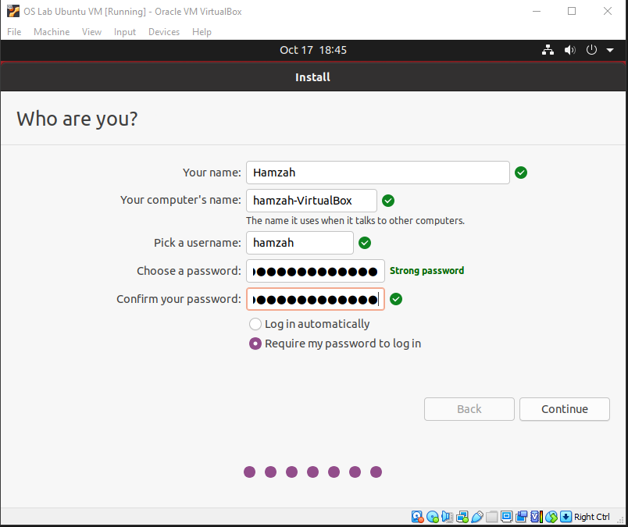
Step 4 - Installing Ubuntu
Enter your information such as Name, Computer Name, Username and Password.
Always make sure to select “Require my password to log in”.

Slide 29
Step 4 - Installing Ubuntu
Finally we just wait for Ubuntu to finish installing.
Once the installation is done, we will restart the machine (it might restart automatically) and VM will automatically boot into our new operating system.

Slide 30
Questions?

Slide 31
03
Working with the Linux Shell
The Swiss Army Knife of Everyday Linux

Slide 32
Working with the Linux Shell
One of the things that shocks newbies to the Linux command line environment is that nearly everything they see is text—command output, errors, data of all kinds, logs, and even emails are just simple text files.
Having the ability to properly manipulate and process large volumes of text is one of the most important attributes of a system administrator; without it you are just continually surrounded by meaningless data.

Slide 33
What is a shell?
A shell is a program designed to interpret the commands users type, parse for expansions and wildcards, and then produce instructions to the computer to accomplish those tasks.
Unless you change the defaults, the Linux shell is normally the bash shell. Of course, many other shells exist.
Among other pieces of information, the user’s default shell is specified in the /etc/passwd entry for that user. If the shell specified does not exist, the user gets the bash shell by default.
Special shells can be specified, such as /bin/false (which returns a nonzero error code, effectively blocking access by a user attempting to log in) or /etc/nologin (which is used to block logins for accounts and echo a message that login is denied).

Slide 34
Types of Shells
 | ash | bash | C-Shell | PD-ksh | T-Shell | Zsh
Binary | ash | bash | csh | pdksh | tcsh | zsh
Job Control | ✘ | ✔ | ✔ | ✔ | ✔ | ✔
Aliases | ✔ | ✔ | ✔ | ✔ | ✔ | ✔
Functions | ✔ | ✔ | ✔ | ✔ | ✔ | ✔
Redirection | ✔ | ✔ | ✔ | ✔ | ✔ | ✔
History | ✔ | ✔ | ✔ | ✔ | ✔ | ✔
Editing | ✔ | ✔ | ✔ | ✔ | ✔ | ✔
Completion | ✔ | ✔ | ✔ | ✔ | ✔ | ✔

Slide 35
Structuring Commands
Option
The flags set that define how it is being executed
ls -l /home
Lists all the files in the /home directory in a formatted list
Command
Argument
The name of the command/utility being run
What we are running the command against

Slide 36

Command Completion
Tab
The tab key can be used to auto complete any commands that you have started typing out, and possibly suggest what arguments you add after the command if you hit the key multiple times!

Slide 37
Command: echo
echo command in linux is used to display line of text/string that are passed as an argument . This is a built in command that is mostly used in shell scripts and batch files to output status text to the screen or a file.
Syntax:
echo [option] [string]
Different functionalities of echo command :
-e : enables the interpretation of backslash escapes
\n : this option creates new line from where it is used.
\t : this option is used to create horizontal tab spaces.
echo * : this command will print all files/folders, similar to ls command .
-n : this option is used to omit echoing trailing newline .

Slide 38
Command: whoami
Command: hostname
whoami command is used both in Unix Operating System and as well as in Windows Operating System.
Syntax:
whoami
A hostname is a name which is given to a computer and it attached to the network. Its main purpose is to uniquely identify over a network.
Syntax:
hostname

Slide 39
Command: uname
Command: exit
The command ‘uname‘ displays the information about the system.
Syntax:
uname [OPTION]
exit command in linux is used to exit the shell where it is currently running.
Syntax:
exit

Slide 40
Command: shutdown
The shutdown command in Linux is used to shutdown the system in a safe way. You can shutdown the machine immediately, or schedule a shutdown using 24 hour format. It brings the system down in a secure way. When the shutdown is initiated, all logged-in users and processes are notified that the system is going down, and no further logins are allowed.
Only root user can execute shutdown command.
Syntax:
shutdown [OPTIONS] [TIME] [MESSAGE]
Examples:
How to use shutdown: sudo shutdown
How to shutdown the system at a specified time: sudo shutdown 05:00
How to shutdown the system at a specified time: sudo shutdown +20
How to shutdown the system immediately: sudo shutdown now
How to broadcast a custom message: sudo shutdown +10 "System upgrade"
How to halt your system: shutdown -H
Notes:
Halting means stopping all CPUs and powering off also makes sure the main power is disconnected.

Slide 41
Command: reboot
reboot command is used restart or reboot the system. In a Linux system administration, there comes a need to restart the server after the completion of some network and other major updates. It can be of software or hardware that are being carried on the server. The reboot is needed so that the changes that the user have done can be affected on the server.
Syntax:
reboot [OPTIONS...]
Examples:
Restart your system: sudo reboot
Command to reboot your system after 5 minutes: sudo shutdown –r +5
Reboot your system after 20 minutes: sudo reboot +20

Slide 42
Command: history
history command is used to view the previously executed command. This feature was not available in the Bourne shell. Bash and Korn support this feature in which every command executed is treated as the event and is associated with an event number using which they can be recalled and changed if required.
Syntax:
history
Examples:
To show the limited number of commands that executed previously as follows: history 5
The whole history can be removed using: history -c

Slide 43
Questions?

Slide 44
04
FILESYSTEM STRUCTURE
The Linux File System

Slide 45
The Filesystem
Most of what you do on a Linux machine involves manipulating files in some manner. You have to know where certain files go, such as binaries, configuration, and user data. You also need to be able to manipulate files from the command line rather than a GUI.
Filesystem Overview
The filesystem’s structure starts with the root of the filesystem, which is denoted by the forward slash character (/). Every item on the filesystem is accessible by a single unique path from the root of the system, such as /usr/local/bin/foobar, no matter which device that file is stored on.
Unix evolved its own set of traditions as to where certain files would go. The fragmentation of the commercial and academic Unixes led to differences in conventions depending on which flavor of Unix you were using.
The Root of the System
Starting in the root (/) directory, the following image lists common top-level directories and includes a short explanation for each:

Slide 46
The Root Directory
Directory | Description
bin | Binaries for all users
boot | Kernel, system map, boot files
dev | Device files
etc | Configuration files for the host
home | Home directories for users
lib | Necessary shared libraries/modules
lost+found | Storage directory for unlinked files (found with fsck)
media | Mount points for removable media
mnt | Temporary mount point for the sysadmin
opt | Third-party application software
proc | Kernel and process information
root | The root user’s home directory
sbin | System binaries needed for boot
tmp | Temporary data
usr | Shareable, read-only data and programs, no host-specific data
var | Variable data, logs, web, ftp, and so on

Slide 47
Questions?

